Slide 1
Hashes
Lesson Introduction
The birthday paradox and length of hash
Secure hash function
HMAC
Notes:
In this lesson, we will discuss hash functions.
We will introduce the birthday paradox and apply it to decide the length of hash to make hash function resistant to collisions.
We will discuss the secure hash function and the HMAC scheme

Slide 2
Hash Functions
Compute message digest of data of any size
Fixed length output: 128-512 bits
Easy to compute H(m)
Given H(m), no easy way to find m
One-way function
Given m₁, it is computationally infeasible to find m₂≠m₁ s.t. H(m₂) = H(m₁)
Weak collision resistant
Computationally infeasible to find m₁≠m₂ s.t. H(m₁) = H(m₂)
Strong collision resistant
Notes:
Let’s review the properties of cryptographic hash functions.
1. H can be applied to a block of data of any size.
2. H produces a fixed-length output.
3. H(x) is relatively easy to compute for any given x, making both hardware and
software implementations practical.
4. For any given code h, it is computationally infeasible to find x such that
H(x) h. A hash function with this property is referred to as one-way or preimage
resistant.
5. For any given block x, it is computationally infeasible to find y ≠ x with
H(y) H(x). A hash function with this property is referred to as second preimage
resistant. This is sometimes referred to as weak
collision resistant.
6. It is computationally infeasible to find any pair (x, y) such that H(x) = H(y).
A hash function with this property is referred to as collision resistant. This is
sometimes referred to as strong collision resistant.

Slide 3
Hash Functions
Requirements for a practical application
of a hash function
Compute message digest of data of any size
Fixed length output: 128-512 bits
Easy to compute H(m)
Given H(m), no easy way to find m
One-way function
Given m₁, it is computationally infeasible to find m₂≠m₁ s.t. H(m₂) = H(m₁)
Weak collision resistant
Computationally infeasible to find m₁≠m₂ s.t. H(m₁) = H(m₂)
Strong collision resistant
Notes:
The first three properties are requirements for the practical application of a hash
function to message authentication.

Slide 4
Hash Functions
Compute message digest of data of any size
Fixed length output: 128-512 bits
Easy to compute H(m)
Given H(m), no easy way to find m
One-way function
Given m₁, it is computationally infeasible to find m₂≠m₁ s.t. H(m₂) = H(m₁)
Weak collision resistant
Computationally infeasible to find m₁≠m₂ s.t. H(m₁) = H(m₂)
Strong collision resistant
The one way property
Notes:
The fourth property is the one-way property: It is easy to generate a code given a
message, but virtually impossible to generate a message given a code. This property is
important if the authentication technique involves the use of a secret value, that is, by hashing the message and a secret together.
The secret value itself is not sent; however, if the hash function is not one way, an attacker
can easily discover the secret value.

Slide 5
Hash Functions
Compute message digest of data of any size
Fixed length output: 128-512 bits
Easy to compute H(m)
Given H(m), no easy way to find m
One-way function
Given m₁, it is computationally infeasible to find m₂≠m₁ s.t. H(m₂) = H(m₁)
Weak collision resistant
Computationally infeasible to find m₁≠m₂ s.t. H(m₁) = H(m₂)
Strong collision resistant
Hash functions are unique to each message
Notes:
The fifth property guarantees that it is impossible to find an alternative message with the same hash value as a given message. This prevents forgery when an encrypted hash code is used.

Slide 6
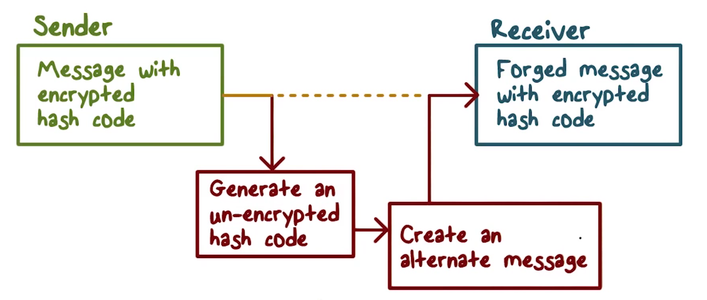
Hash Functions
Notes:
If this property were not true, an attacker would be capable of the following sequence:
---
First, observe or intercept a message plus its encrypted hash code;
Second, generate an unencrypted hash code
from the message;
Third, generate an alternate message with the same hash code.
A hash function that satisfies the first five properties in the preceding list is referred to as a weak hash function.

Slide 7
Hash Functions
Compute message digest of data of any size
Fixed length output: 128-512 bits
Easy to compute H(m)
Given H(m), no easy way to find m
One-way function
Given m₁, it is computationally infeasible to find m₂≠m₁ s.t. H(m₂) = H(m₁)
Weak collision resistant
Computationally infeasible to find m₁≠m₂ s.t. H(m₁) = H(m₂)
Strong collision resistant
Notes:
If the sixth property is also satisfied, then it
is referred to as a strong hash function. A strong hash function protects against an attack in which one party generates a message for another party to sign.

Slide 8
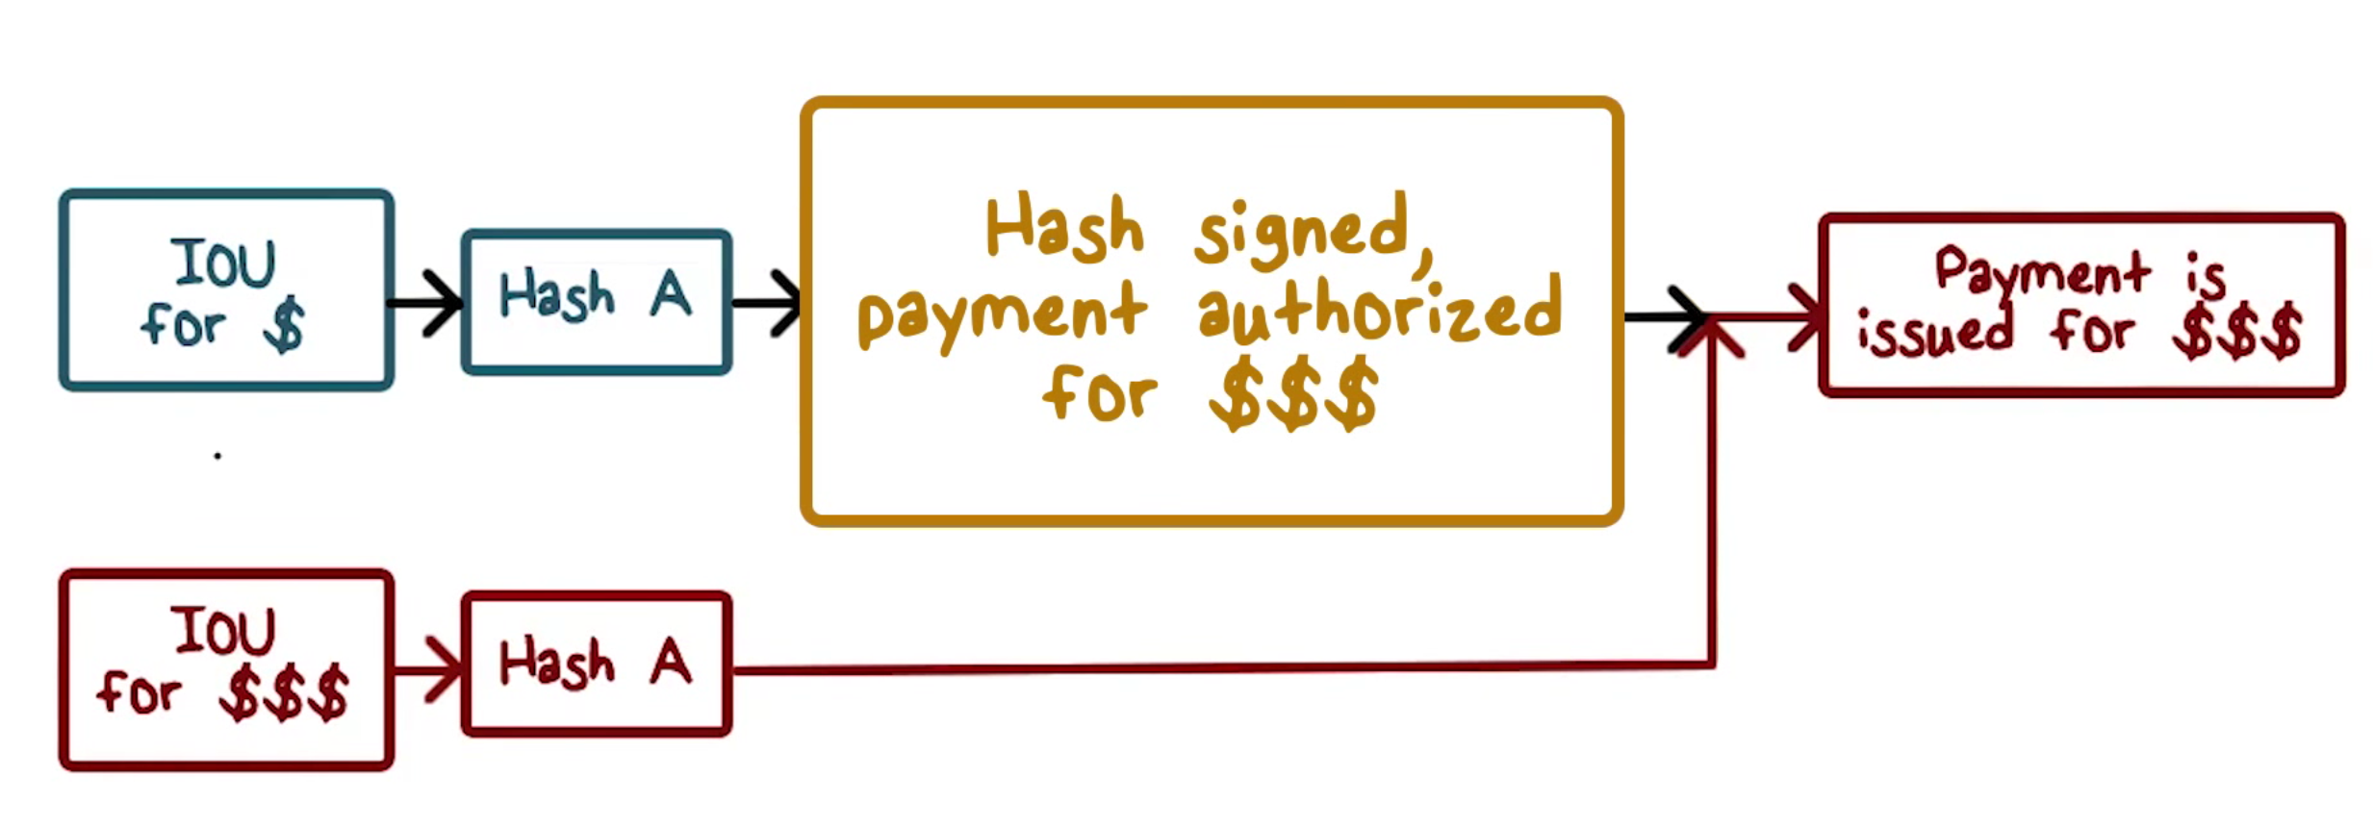
Hash Functions
Notes:
For example, suppose Bob gets to write an IOU message, send it to Alice, and she signs it.
Bob finds two messages with the same hash, one of which requires Alice to pay a small amount and one that requires a large payment. Alice signs the first message and Bob is then able to claim that the second message is authentic.
Of course, a hash function that is strong collision resistant is automatically weak collision resistant.

Slide 9


Hash Function Weaknesses
Pigeonhole Principle
The Birthday Paradox
Notes:
To understand the possible exploitation of hash functions, there are two concepts we need to discuss: the pigeonhole principle and the birthday paradox.

Slide 10
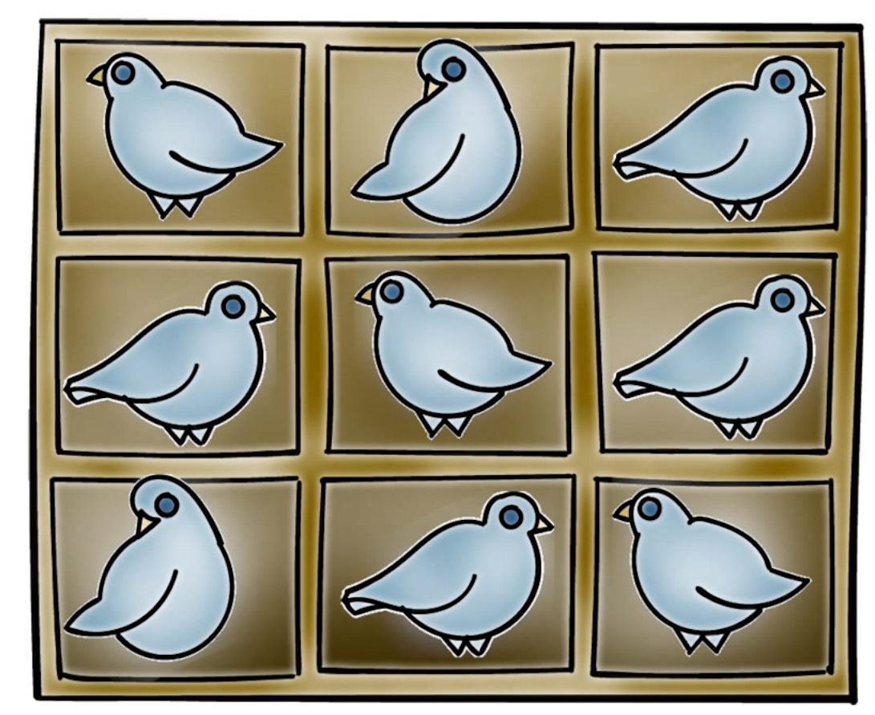
Hash Function Weaknesses
Pigeonhole Principle
n = number of pigeons
m = number of holes
n = m There is one pigeon per hole
n > m Then at least one hole must have more than one pigeon
Notes:
Imagine you have are 9 pigeon holes
----
If we have 9 pigeons, one pigeon can be placed in each hole.
----
If we add another pigeon, there will be one box with two pigeons.
n = number of pigeons
m = number of holes
n = m There is one pigeon per hole
n > m Then at least one hole must have more than one pigeon
We can generalize and say…
Anytime we have n items to put in m containers, if n > m, then at least one container must have more than one item

Slide 11
Hash Function Weaknesses
The Birthday Paradox
How many people do you need in a room before you have a greater than 50% chance that two of them will have the same birthday?
Assume 365 birthdays (our containers)
% chance that two people in the room have the same birthday:
100% requires 366 people (the pigeonhole principle)
Notes:
Let’s apply the Pigeonhole principle to another problem. How many people do you need in a room before you have a greater than 50% chance that you’d find two of them sharing the same birthday?
Assume we have 365 birthdays, our containers. To achieve 100% chance that two people share the same birthday we would need 366 people to be in the room.

Slide 12
Hash Function Weaknesses
The Birthday Paradox
Compute probability of different birthdays
Random sample of n people (birthdays) taken from k (365) days
k^{n} samples with replacement
(k)_{n}=k(k-1)…(k-n+1) sample without replacement
Probability of repetition:
p = 1- (k)_{n}/k^{n} ≈ n(n-1)/2k = 0.5 if n=√k
Notes:
We can solve the problem using the following algorithm:
Compute probability of different birthdays
Random sample of n people (birthdays) taken from k (365) days
k^{n} samples with replacement
(k)_{n}=k(k-1)…(k-n+1) sample without replacement
Probability of repetition:
p = 1- (k)_{n}/k^{n} ≈ n(n-1)/2k = 0.5 if n=√k
This is an approximation

Slide 13
Hash Function Weaknesses
The Birthday Paradox
1-(k)_{n}/k^{n}= the probability that a pair share the same birthday
If k = 365, n = 19
If there are 19 people in a room, there is a good chance that two of them share the same birthday!
Notes:
Thus, if k=365, then n = 19. That is, if have more than 19 people in a room, there is a very good chance that two of them share the same birthday.
I have tried this in my class every year, with my students in the classroom, and it always works as the math tells us!

Slide 14
Hash Function Weaknesses
Hash Functions:
There are many more ‘pigeons’ than ‘pigeonholes’
Many inputs will be mapped to the same output. That is, many input messages will have the same hash.
Conclusion: The longer the length of the hash, the fewer collisions.
Notes:
Some of these properties seem to contradict each other.
In particular, since the input can be any length and the output is of fixed length, this means that there are many more, in fact infinitely more, possible inputs that are mapped to a fixed number of outputs. Therefore, many inputs will be mapped to the same output. That is, many input messages will have the same hash.
But the collision free property says that it should be computationally infeasible to find two different input messages that have the same hash. How can this be accomplished? Obviously, the larger the number of possible output hash values, the harder to find a collision. In other words, the longer the length of the output hash value, the better.
But how long is sufficient to make it computationally infeasible to find collision?

Slide 15
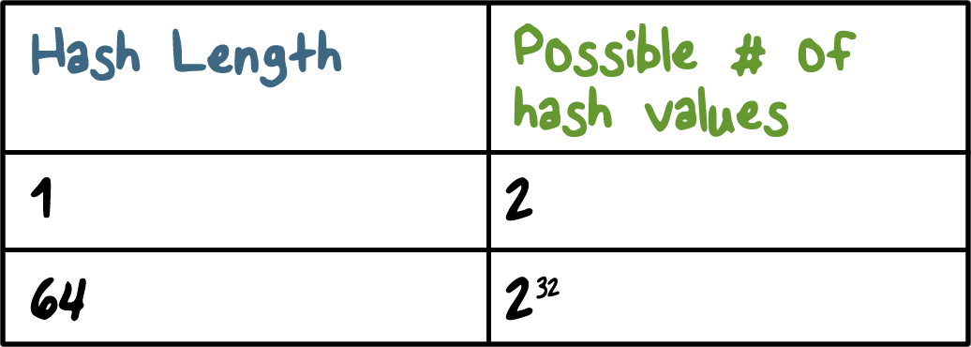
Determining Hash Length
Notes:
So now, let’s turn our attention to our original problem: how many bits should a hash have so that it is computationally infeasible to find two different messages that have the same hash?
Suppose the hash has l bits, then there are 2^l possible hash values, and according to the result from the Birthday Paradox we just discussed, if an attacker tries square root of 2^l, that is, 2^(l/2), that many messages, he has a good chance of finding a hash collision.
If the hash value only has 64 bits, that means that attacker only needs to try 2^(32) messages, which is quite feasible with today’s computing power.
Therefore, we need to use longer hash value in order to achieve hash resistance. We should use at least 128 bits.

Slide 16

Hash Size Quiz
Choose the correct answer:
If the length of hash is 128 bits, then how many messages does an attack need to search in order to find two that share the same hash?
128
2¹²⁷
2¹²⁸
2⁶⁴
Notes:
Quiz:
Discuss
----
Solution:
Discuss

Slide 17

Secure Hash Algorithm
Developed by NIST, specified in the Secure Hash Standard, originally 1993
Revised as SHA-1 in 1995
160 bit hash
NIST specified SHA2 algorithms in 2002
Hash value lengths of 256, 384, and 512
Similar to SHA-1
Notes:
The Secure Hash Algorithm (SHA) was developed by the National Institute of
Standards and Technology (NIST) and published as a federal information processing
standard (FIPS 180) in 1993; a revised version was issued as FIPS 180-1 in 1995
and is generally referred to as SHA-1.
SHA-1 produces a hash value of 160 bits. In 2002, NIST produced a revision of the standard, FIPS 180-2, that defined three new versions of SHA, with hash value lengths of 256, 384, and 512 bits, known as SHA-256, SHA-384, and SHA-512. Collectively, these hash algorithms are known as SHA-2 .
These new versions have the same underlying structure and use the same types of modular
arithmetic and logical binary operations as SHA-1.

Slide 18
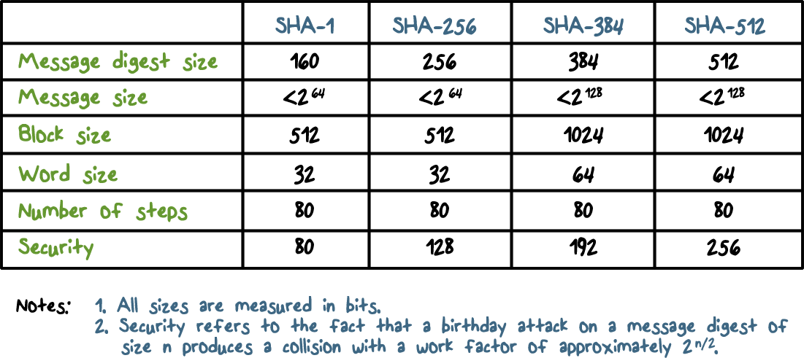
Comparison of SHA Parameters
Notes:
The table Comparison of SHA parameters. Message digest size is the number of bits of hash, message size is the size limit of the input message. You can consider these size limits as not having effect in practice because most, if not all, messages will be smaller. For example, with limit of 2^(64) you can hash a message so big that it occupies the entire address space of a 64-bit computer. Or think about it in another way, 2^(43) bits is already a terabyte.
As we can see, the algorithms from left to right produce hash with more bits, hence are more secure with regard to collision resistance, and they also have a higher limit on input size.
In this lecture, we provide a description of SHA-512. The other versions are quite similar. The algorithm takes as input a message with a maximum length of
less than 2¹²⁸ bits and produces as output a 512-bit message digest. The input is processed in 1024-bit blocks.

Slide 19
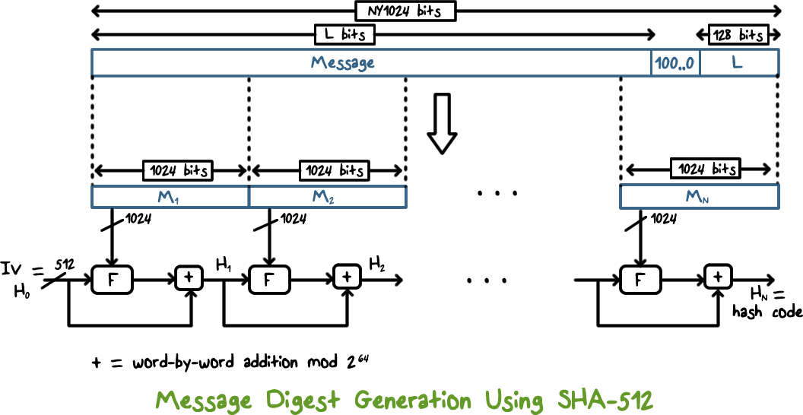
Message Processing
Notes:
This figure shows the overall processing of a message
to produce a digest. The processing consists of the following steps:
• Step 1: Append padding bits and message length so that message length a multiple of 1024 because the message is processed in 1024-bit block The padding consists of a single 1-bit followed by the necessary number of 0-bits but leave space for 128 bits so that an unsigned 128-bit integer length of the original message (before padding) is also appended at the end.
• Step 2: Initialize hash buffer: to the specified 64-bit integer values; this initialization vector is hardcoded into the algorithm.
• Step 3: Process the message in 1024-bit (128-word) blocks, one block a time. The result of processing the current block is input to the processing of next block. When processing the first block, the initialization vector is used. The logic of this per-block processing is described on the next slide.
• Step 4: Output the final hash buffer value as the resulting hash

Slide 20
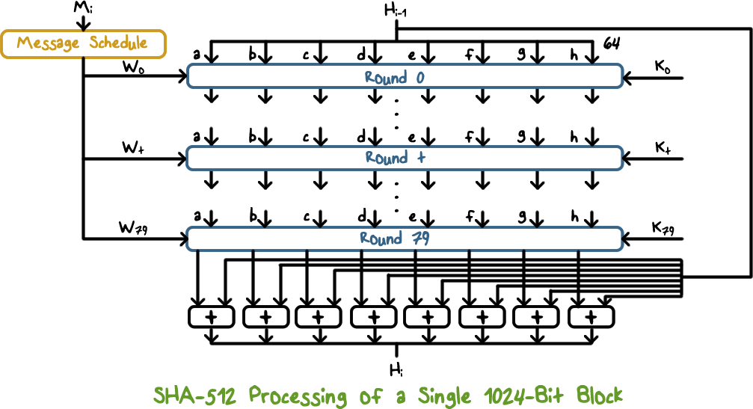
Message Processing
Notes:
The processing of each block takes 80 rounds
Each round takes as input the 512-bit buffer value abcdefgh, and updates the contents of the buffer. At input to the first round, the buffer has the value of the intermediate hash value, H_{i–1} that is the result of processing the previous block.
Each round t makes use of a 64-bit value W_{t}, derived from the current 1024-bit block being processed (M_{i}). Each round also makes use of an additive constant K_{t}, where 0 ≤ t ≤ 79 indicates one of the 80 rounds. These words represent the first sixty-four bits of the fractional parts of the cube roots of the first eighty prime numbers. The constants provide a “randomized” set of 64-bit patterns, which should eliminate any regularities in the input data. The operations performed during a round consist of circular shifts, and primitive Boolean functions based on AND, OR, NOT, and XOR.
The output of the eightieth round is added to the input to the first round (H_{i–1}) to produce H_{i}.

Slide 21
Hash Based Message Authentication
Cryptographic hash functions generally execute faster
Library code is widely available
SHA-1 was not designed for use as a MAC because it does not rely on a secret key
Issued as RFC2014
Has been chosen as the mandatory-to-implement MAC for IP security
Used in other Internet protocols such as Transport Layer Security (TLS)
Notes:
Let’s discuss the hash-code approach to message authentication.
In recent years,
there has been increased interest in developing a MAC derived from a cryptographic
hash code, such as SHA-1. The motivations for this interest are as follows:
• Cryptographic hash functions generally execute faster in software than conventional encryption algorithms such as DES.
• Library code for cryptographic hash functions is widely available.
A hash function such as SHA-1 was not designed for use as a MAC and cannot be used directly for that purpose because it does not rely on a secret key.
There have been a number of proposals for the incorporation of a secret key
into an existing hash algorithm. The approach that has received the most support
is HMAC [BELL96]. HMAC has been issued as RFC 2104, has been chosen as
the mandatory-to-implement MAC for IP Security, and is used in other Internet
protocols, such as Transport Layer Security (TLS, soon to replace Secure Sockets
Layer).

Slide 22
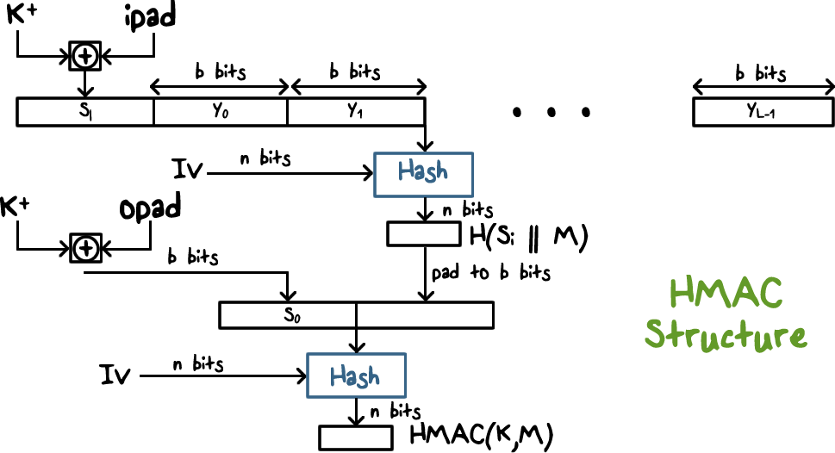
Hash Based Message Authentication
Notes:
This figure illustrates the overall operation of HMAC.
In words:
1. Append zeros to the left end of key K to create a b-bit string K⁺ (e.g., if K is of length 160 bits and b = 512, then K will be appended with 44 zero bytes 0x00).
2. XOR (bitwise exclusive-OR) K⁺ with ipad to produce the b-bit block S_{i}.
3. Append message M to S_{i}.
4. Apply H to the stream generated in step 3.
5. XOR K⁺ with opad to produce the b-bit block S_{o}.
6. Append the hash result from step 4 to S_{o}.
7. Apply H to the stream generated in step 6 and output the result.
Note that the XOR with ipad results in flipping one-half of the bits of K .
Similarly, the XOR with opad results in flipping one-half of the bits of K , but a
different set of bits. In effect, by passing S _{i} and S _{o} through the hash algorithm, we
have pseudorandomly generated two keys from K

Slide 23

HMAC Security
Security depends on the cryptographic strength of the underlying hash function
It’s much harder to launch successful collision attacks on HMAC because of secret key
Notes:
The security of any MAC function based on an embedded hash function depends
in some way on the cryptographic strength of the underlying hash function.
The probability of successful attack on HMAC is equivalent to one of the following attacks on the
embedded hash function:
1. The attacker is able to compute a correct output even with an IV that is random, secret, and unknown to the attacker.
2. The attacker finds collisions in the hash function even when the IV is random and secret.

Slide 24
Hash Function Quiz
Check the statements that are True:
The one-way hash function is important not only in message authentication but also in digital signatures
SHA processes the input one block at a time but each block goes through the same processing
HMAC is secure provided that the embedded hash function has good cryptographic strengths such as one-way and collision resistant
Notes:
Quiz:
Discuss
----
Solution:
Discuss

Slide 25
Hashes
Lesson Summary
Hash length should be at least 128
2^(64) message to find collision
SHA1: 160-bit hash; SHA2: 256/384/512-bit hash
Message processed/hashed block by block, result to next
HMAC: hash the message with a secret key
Message authentication
Notes:
Discuss

